Slide 1
Mathematical Modeling and Engineering Problem solving
1
Chapra: Chapter-1

Slide 2
Mathematical Modeling and Engineering Problem solving
Requires understanding of engineering systems
By observation and experiment
Theoretical analysis and generalization
Computers are great tools, however, without fundamental understanding of engineering problems, they will be useless.

Slide 3
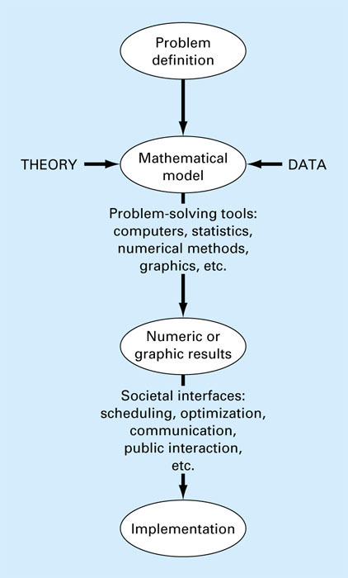
Fig. 1.1
Chapra

Slide 4
A mathematical model is represented as a functional relationship of the form
Dependent independent forcing
Variable = f variables, parameters, functions
Dependent variable: Characteristic that usually reflects the state of the system
Independent variables: Dimensions such as time and space along which the systems behavior is being determined
Parameters: reflect the system’s properties or composition
Forcing functions: external influences acting upon the system

Slide 5
Newton’s 2nd law of Motion
States that “the time rate change of momentum of a body is equal to the resulting force acting on it.”
The model is formulated as
F = m a
F = net force acting on the body (N)
m = mass of the object (kg)
a = its acceleration (m/s²)

Slide 6
Formulation of Newton’s 2nd law has several characteristics that are typical of mathematical models of the physical world:
It describes a natural process or system in mathematical terms
It represents an idealization and simplification of reality
Finally, it yields reproducible results, consequently, can be used for predictive purposes.

Slide 7
Some mathematical models of physical phenomena may be much more complex.
Complex models may not be solved exactly or require more sophisticated mathematical techniques than simple algebra for their solution
Example, modeling of a falling parachutist:

Slide 8
F_{U}
c is the proportionality constant called the drag coefficient(kg/s)
F_{D}

Slide 9
Exact Solution
This is a differential equation and is written in terms of the differential rate of change dv/dt of the variable that we are interested in predicting.
If the parachutist is initially at rest (v = 0 at t = 0), using calculus
Independent variable
Dependent variable
Parameters
Forcing function

Slide 10
Numerical Solution
Find and compare the values of v(t) at t={0, 2, 4, 6, 8 …}
Using Exact solution
Using Numerical solution
Compare the results

Slide 11
t | Actual | Estimate
0 | 0 | 0
2 | 16.42172 | 19.62
4 | 27.79763 | 32.03736
6 | 35.67812 | 39.89621
8 | 41.13722 | 44.87003
10 | 44.91893 | 48.01792
12 | 47.53865 | 50.01019
14 | 49.35343 | 51.27109
16 | 50.61058 | 52.06911
18 | 51.48146 | 52.57416
20 | 52.08475 | 52.89381
22 | 52.50267 | 53.09611
24 | 52.79218 | 53.22415
26 | 52.99273 | 53.30518
28 | 53.13166 | 53.35646
30 | 53.2279 | 53.38892
32 | 53.29457 | 53.40946
m= | 68.1
c= | 12.5
9= | 9.81
∆t= | 2

Slide 12
Why Numerical?
There exists many cases where analytical/exact solution is not possible
We can have generic numeric methods for solving a variety of mathematical forms

Slide 13
Conservation Laws and Engineering
Conservation laws are the most important and fundamental laws that are used in engineering.
Change = increases – decreases (1.13)
Change implies changes with time (transient). If the change is nonexistent (steady-state), Eq. 1.13 becomes
Increases =Decreases

Slide 14
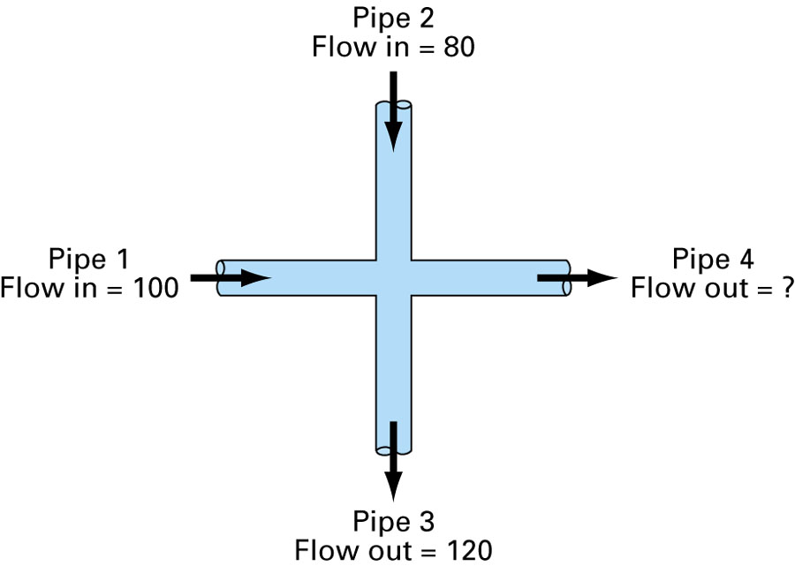
Fig 1.6
For steady-state incompressible fluid flow in pipes:
Flow in = Flow out
or
100 + 80 = 120 + Flow₄
Flow₄ = 60

Slide 15
Truncation Errors and Tailors Series
1
Chapra: Chapter-4

Slide 16
Truncation Error
Truncation errors are those that result from using an approximation in place of an exact mathematical procedure.
Example:
How much error is introduced with this approximation?
We can use Tailors Series to estimate truncation error.

Slide 17
Tailors Series
n^{th} order approximation
(x_{i+1}-x_{i})= h step size (define first)
Reminder term, R_{n}, accounts for all terms from (n+1) to infinity.

Slide 18
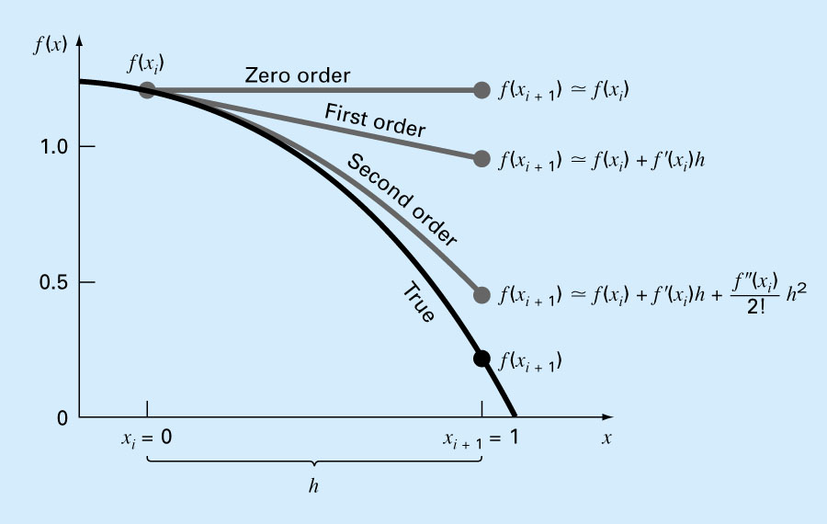
The approximation of f(x) at x=1 by zero-order, fist-order and second-order Tailor series expansion

Slide 19
Insight
Each additional term contributes to the approximation
n^{th}-order Tailor Series gives exact value of n^{th}-order polynomial
Inclusion of a few terms gives an approximation that is good enough for practical purpose.
The Remainder:
ε is not exactly known.
Need to determine f^{n+1}(x_{i+1}), which require the determination of the (n+1)th derivative of f(x). If we know f(x) then we do not need to use Tailors series!
Yet, R_{n}=O(h^{n+1}) gives insight into error. E.g., if error is O(h) then halving step size will halve the error. If error is O(h²) then halving the step size will quarter the error, and so on.

Slide 20
Effect of Step Size
Estimate
t | Actual | Estimate | Error%
0 | 0 | 0
1 | 8.962318 | 9.81 | 9.458288
2 | 16.42172 | 17.81934 | 8.510793
3 | 22.63024 | 24.35854 | 7.637128
4 | 27.79763 | 29.69744 | 6.834436
5 | 32.09849 | 34.05637 | 6.099607
6 | 35.67812 | 37.6152 | 5.429315
7 | 38.65748 | 40.52079 | 4.820066
8 | 41.13722 | 42.89306 | 4.268249
9 | 43.20112 | 44.82988 | 3.770176
10 | 44.91893 | 46.4112 | 3.322138
11 | 46.34867 | 47.70225 | 2.920443
12 | 47.53865 | 48.75633 | 2.561458
13 | 48.52908 | 49.61693 | 2.241647
14 | 49.35343 | 50.31957 | 1.957596
15 | 50.03953 | 50.89323 | 1.706043
16 | 50.61058 | 51.36159 | 1.483897
Actual
t | Actual | Estimate | Error%
0 | 0 | 0
2 | 16.42172 | 19.62 | 19.47591
4 | 27.79763 | 32.03736 | 15.25213
6 | 35.67812 | 39.89621 | 11.82263
8 | 41.13722 | 44.87003 | 9.074043
10 | 44.91893 | 48.01792 | 6.899074
12 | 47.53865 | 50.01019 | 5.199019
14 | 49.35343 | 51.27109 | 3.885579
16 | 50.61058 | 52.06911 | 2.881848
m= | 68.1
c= | 12.5
9= | 9.81
∆t= | 2

Slide 21
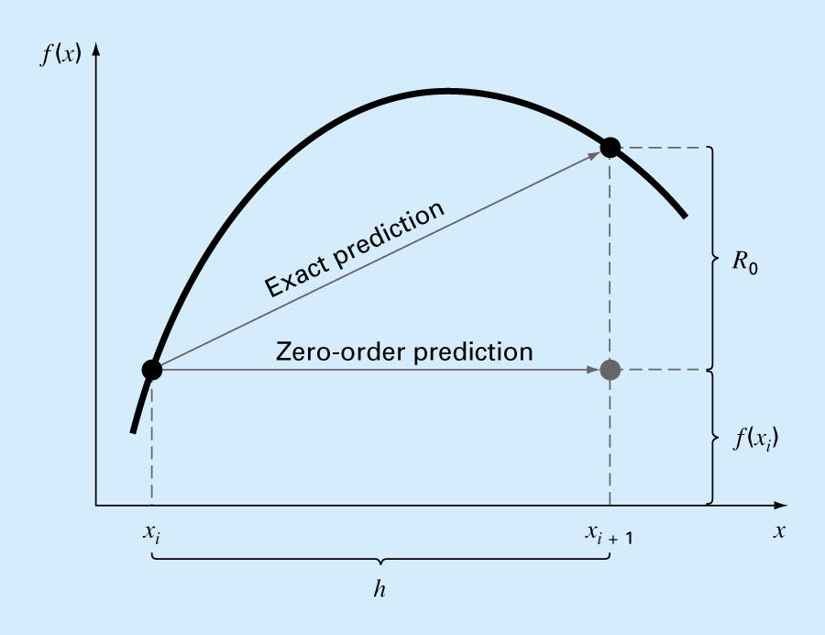
Insight : R_{n}

Slide 22
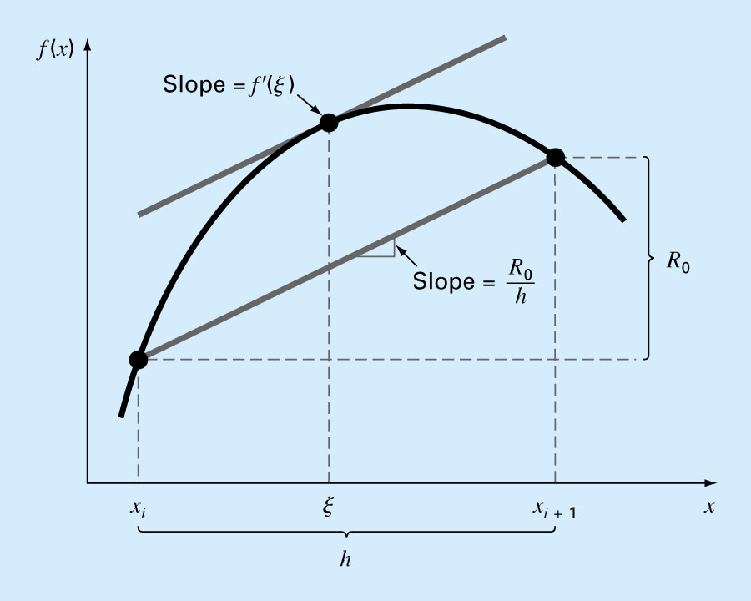
Insight : R_{n}

Slide 23
How to get derivatives?
We will be given value of unknown f(x) for some value of x
We can estimate f^{n}(a), i.e. the n^{th} order derivate of f(x) at x=a numerically without knowing f(x)

Slide 24
Approximations & Round-off Errors
1
Chapra: Chapter-3

Slide 25
For many engineering problems, we cannot obtain analytical solutions
Numerical methods yield approximate solution that are close to the exact analytical solution. We cannot exactly compute the errors associated with numerical methods.
Only rarely given data are exact, since they originate from measurements. Therefore there is probably error in the input information.
Algorithm itself usually introduces errors as well, e.g., unavoidable round-offs, etc …
The output information will then contain error from both of these sources.
How confident we are in our approximate result?
The question is “how much error is present in our calculation and is it tolerable?”

Slide 26
Accuracy. How close is a computed or measured value to the true value
Precision (or reproducibility). How close is a computed or measured value to previously computed or measured values.
Inaccuracy (or bias). A systematic deviation from the actual value.
Imprecision (or uncertainty). Magnitude of scatter.

Slide 27
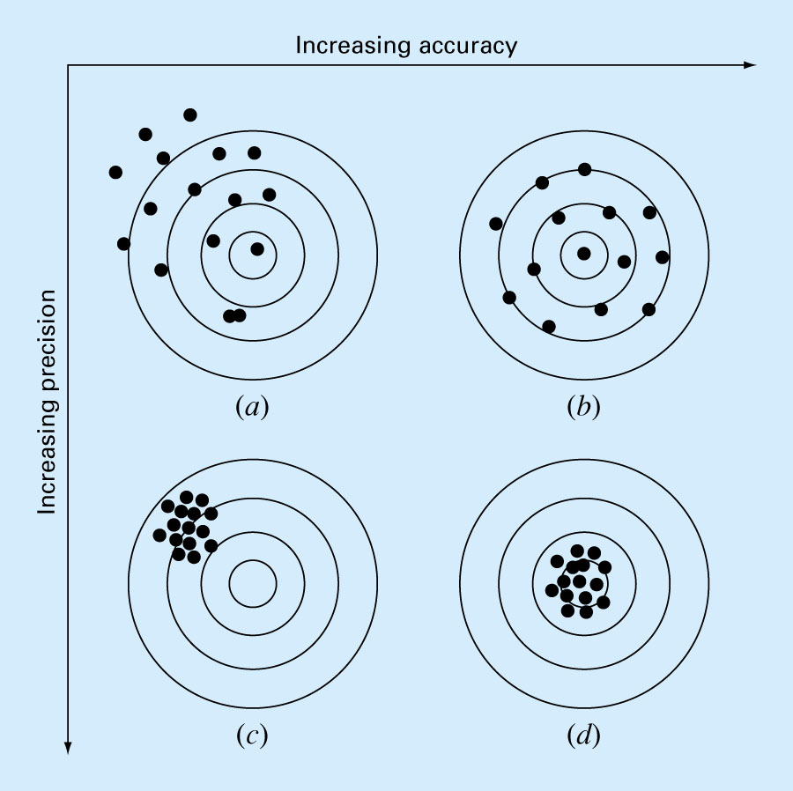
Fig. 3.2

Slide 28
Significant Figures
Number of significant figures indicates precision. Significant digits of a number are those that can be used with confidence, e.g., the number of certain digits plus one estimated digit.
53,800 How many significant figures?
5.38 x 10⁴ 3
5.380 x 10⁴ 4
5.3800 x 10⁴ 5
Zeros are sometimes used to locate the decimal point not significant figures.
0.00001753 4
0.0001753 4
0.001753 4

Slide 29
Error Definitions
True Value = Approximation + Error
E_{t} = True value – Approximation (+/-)
True error

Slide 30
For numerical methods, the true value will be known only when we deal with functions that can be solved analytically (simple systems). In real world applications, we usually not know the answer a priori. Then
Iterative approach, example Newton’s method
(+ / -)

Slide 31
Use absolute value.
Computations are repeated until stopping criterion is satisfied.
If the following criterion is met
you can be sure that the result is correct to at least n significant figures.
Pre-specified % tolerance based on the knowledge of your solution

Slide 32
Example 3.2
In mathematics, function can often be represented by infinite series. For example, the exponential function can be computed using the Maclaurin series exapansion as:
Thus, as more terms are added in sequence, the approximation becomes a better and better estimate.
Starting with the simplest version, e^{x}=1, add terms one at a time to estimate e^{0.5}. After each new term is added, compute the true and approximate percent relative errors. Note that the true value of e^{0.5} = 1.648721. Add terms until the absolute value of the approximate error estimate ε_{a} falls below a pre-specified error criterion ε_{s} conforming to three significant digits.

Slide 33
Round-off Errors
Numbers such as π, e, or cannot be expressed by a fixed number of significant figures.
Computers use a base-2 representation, they cannot precisely represent certain exact base-10 numbers.
Fractional quantities are typically represented in computer using “floating point” form, e.g.,
Integer part
exponent
mantissa
Base of the number system used

Slide 34
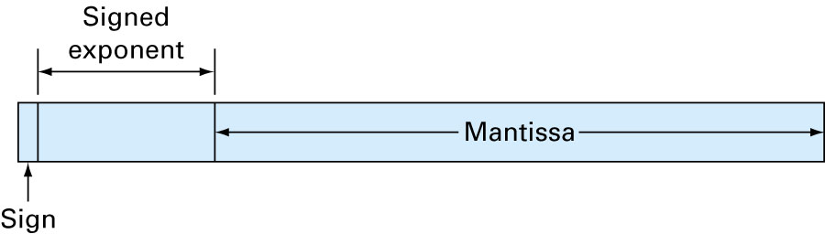
Integer part
exponent
mantissa
Base of the number system used

Slide 35
Suppose only 4 decimal places to be stored
Normalized to remove the leading zeroes. Multiply the mantissa by 10 and lower the exponent by 1
0.2941 x 10⁻¹
Additional significant figure is retained

Slide 36
Therefore
for a base-10 system 0.1 ≤m<1
for a base-2 system 0.5 ≤m<1
Floating point representation allows both fractions and very large numbers to be expressed on the computer. However,
Floating point numbers take up more room.
Take longer to process than integer numbers.
Round-off errors are introduced because mantissa holds only a finite number of significant figures.

Slide 37
Chopping
Example:
π=3.14159265358 to be stored on a base-10 system carrying 7 significant digits.
π=3.141592 chopping error ε_{t}=0.00000065
If rounded
π=3.141593 ε_{t}=0.00000035
Some machines use chopping, because rounding adds to the computational overhead. Since number of significant figures is large enough, resulting chopping error is negligible.

